Slide 1
Traffic Management System
Innovative Solutions to Address Congestion Issues by Aiym Aibekova

Slide 2
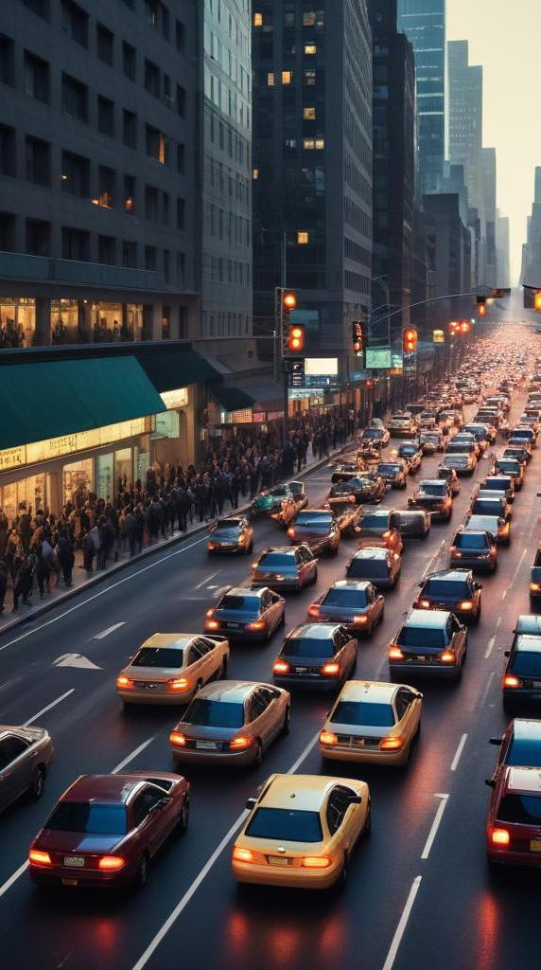
The issue of traffic congestion
Let's face it, traffic in the US can be a real nightmare. It's not just a minor annoyance; it seriously messes with people's lives.
Think about it: we're talking about hours wasted sitting in gridlock, gas money down the drain, and the daily stress it adds to everyone's commute.
It's not just about numbers; it's about the frustration of missing important appointments, the lost time with family, and the overall hit to our well-being
Congestion results in significant economic losses due to wasted time and fuel. Increased stress levels for drivers can lead to negative health outcomes possibly tiring them more and causing accidents, while the environmental impact heightens concerns about sustainability.

Slide 3
Limitations of existing tech
Current solutions like dynamic traffic lights and speed cameras react to congestion but have flaws that could be carried out more efficiently. Routing apps provide directions but do not address overall traffic system overload, leading to persistent congestion.
Okay, we've got some tech in place already. We've got those dynamic traffic lights that try to adjust, and those speed cameras that catch people running red lights. But here's the thing: those lights often feel like they're reacting to the problem after it's already happened. They're not preventing the jam in the first place. And those navigation apps we all use? They're great for finding your best route, but they can actually make things worse by sending everyone down the same side street

Slide 4
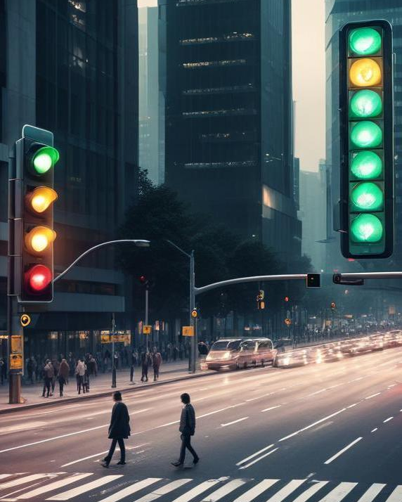
Compassionate innovation goal
My goal is to create an intelligent traffic management system that improves traffic flow equitably. The aim is to prioritize driver’s safety.
Instead of waiting for incidents to happen, our agents proactively estimate risk and suggest interventions before accidents happen
In a real deployment, human operators could override the AI to account for information the model doesn't have eg. a traffic event just cleared up. This keeps AI power in accountability
So, I wanted to come up with something better. Something that actually solves the traffic problem, not just manages it.
KEY: A system that helps everyone get where they need to go, without leaving anyone behind and wasting our valuable time, besides it will be more convenient for the government forces if there is an effective alternative
The key idea here is to stop waiting for accidents to happen. Instead of just reacting to the chaos, let's try to predict it!

Slide 5
DETAILS
The core innovation of this system lies in moving beyond reactive responses to traffic disruptions by predicting potential incidents
To do this, we'll pull together a various data sets:
look at patterns in past traffic data:
-Where do jams happen most often?
-What time of day?We'll factor in the weather: Rain, snow, fog – they all make things worse.We'll even consider events: Is there a big concert downtown tonight?
-A sports game?We'll use smart cameras that can automatically spot accidents or road closures. And we'll get real-time data from cars themselves, telling us about their speed and any problems they see.
We can let people report problems using their phones, so we get info from people on the ground connected to satellites
When the system predicts a potential problem, it jumps into action:It starts rerouting traffic before the jam even forms, guiding people onto alternative routes. It automatically alerts emergency services, giving them the exact location and how bad the situation is likely to be. Now, I know AI can be powerful, but we can't let it run completely wild. Humans need to be in the loop, especially when safety is on the line.So, the system will recommend actions, but a human operator will always have the final say, especially in tricky situations.

Slide 6
Why use this and how?
KEY differentiator - ability to dynamically reroute traffic. However, rerouting will only be triggered if a threshold number of drivers have already been redirected, in order to avoid oversaturating alternate routes
Congestion credit system: allocates monthly congestion credits to users, rewarding off-peak travel and encouraging better driving habits, promotes fair access to roadways.
In the long term, the implementation of roadside sensors—though potentially expensive—can provide critical data points that help prevent accidents, detect abnormal conditions or hazards, enhancing the system’s predictive capabilities.
Alternatively, vehicle-based telemetry could play a crucial role. By analyzing traffic patterns, accident frequency, weather, and event data, we can identify high-risk zones. This insight could inform city planning decisions, such as placing hospitals or emergency response stations closer to vulnerable areas.
Ethical considerations: anonymize user data to protect user information.
Historical Traffic Data (Google Maps API); Weather Data (OpenWeatherMap); Event Data(Eventbrite); Car Telemetry: Uber partnership; ML Models: Random Forests, XGBoost, for time series prediction; Anomaly Detection: For detecting unusual traffic patterns; Geospatial Analysis: Use Geopandas, Folium, or QGIS to visualize risk areas

Slide 7
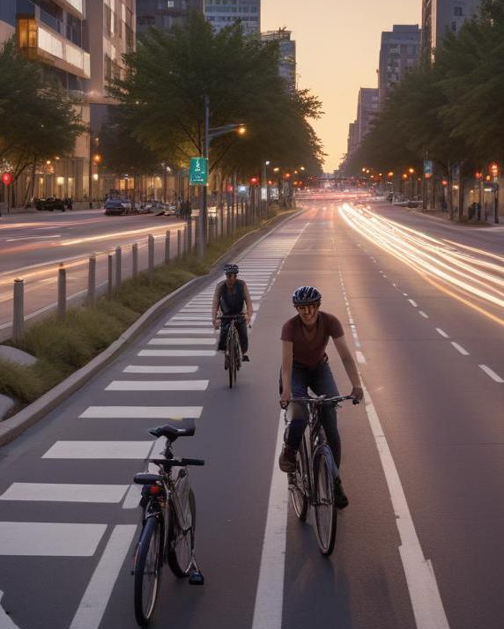
Conclusions
I think this approach creates a fair, efficient, and user-centered traffic management system.
Because traffic jams affect everyone, but they hit some people harder than others. We need to make sure this system doesn't make that worse.
- We'll be really careful to analyze the data and make sure it's not favoring certain neighborhoods or pushing traffic into low-income areas.
And about those congestion fees? We'll make it fair. Maybe everyone gets a certain number of free trips, or we adjust the price based on income
Another key point, people are worried about their privacy. We need to be super careful with their data.We'll scramble their location data so no one can track individuals. We'll be upfront about what data we collect and why because we can't let hackers mess with a system that controls traffic by using top-notch encryption and have backups in place, so the system keeps working even if something goes
And we'll give people a way to give feedback or appeal decisions.
This system has to react to things in real-time. If there's an accident, if traffic suddenly gets worse, the system needs to respond automatically.The system needs to remember what's happening. Cars need to know their speed, lights need to know their timing, and the system as a whole needs to track the overall flow.
Finally, I can't stress this enough: Humans are essential. We need to design the system so that people can easily step in and take control when needed. It needs to make use of what's already out there: existing traffic lights, navigation systems, emergency services.
This is about making something that's right.

